Slide 1
Making Kubectl PowerShell Friendly
The PoSh Wolf
https://github.com/theposhwolf/sessions

Slide 2
Who is The PoSh Wolf?
Anthony Howell
From Eugene, OR USA so I like to
~3.3 kids, 2 dogs, 1 wife, 1 cat
In IT since 2012
Blogger (https://theposhwolf.com)
Twitter (https://twitter.com/theposhwolf)
Pluralsight author (https://pluralsight.com)
Consulting (https://howell-it.com)
Employed

Slide 3
Overview
What is the problem?
Why not Crescendo or -o json?
Technical solution
Parsing output
Generating PowerShell formats
Reducing reliance on Where-Object

Slide 4
CAUTION: Opinion ahead

Slide 5
The Problem
Kubectl is just stdout

Slide 6
Crescendo or -o json?
Crescendo
Definitely more PowerShell-y (verb-noun)
Not cross-shell compatible
Not a bad tool, just not the right tool for the job
kubectl get pod -o json | ConvertFrom-Json
Too much typing
Too much data, usually

Slide 7
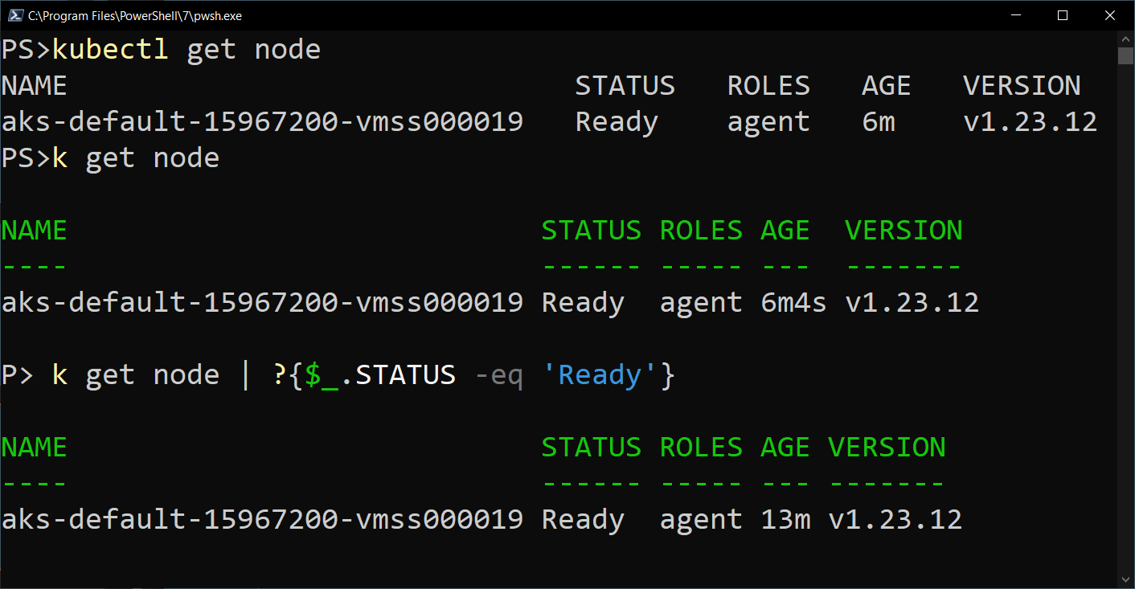
My Solution

Slide 8
Prerequisites
PowerShell
Kubectl

Slide 9
Demo Environment
Windows 10
VS Code (latest version)
PowerShell 7.3.3
specialK
Kubectl

